Slide 1
INTRODUCTION TO HTML CSS JAVASCRIPT
Name : Karthik.M
Reg No : 24524U18040
NM ID : F7EC8E2F3CD1450A57B43905A9E4482E

Slide 2

INTRODUCTION TO WEB DEVELOPMENT
Web development is the process of creating and maintaining websites. It covers everything from designing how a site looks to making it work smoothly and securely

Slide 3
HTML
INTRODUCTION:
HTML stand for hyper text markup language
HTML is the standard markup language for creating web page
HTML describes the structure of a web page

Slide 4
HTML TAGS:
TAGS
DESCRIPTION
<! DOCTYPE>
<a>
<b>
<body>
<br>
<button>
<div>
Defines a document type.
Defines a hyperlink.
Defines a bold text.
Defines a document‘s body.
Defines a single line break.
Defines a clickables button.
Defines a section in a document.

Slide 5
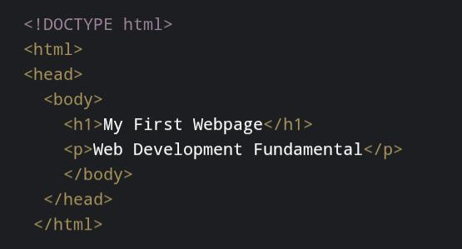
STRUCTURE OF HTML:
The HTML document must start with a document type declaration <! DOCTYPE>
The HTML document itself begins with <html> and ends With</html>
The visible part of the html document is between <body> and</body>
Example:

Slide 6
CSS
NTRODUCTION:
Css is the language we use to style a web page.
Css stands for Cascading style sheets.
Css describes how HTML element are to be displayed on screen, paper, or in other media.
Css save a lot of work. If can control the layout of multiple web page all at once.
External stylesheet are stored in css files.

Slide 7
SYNTAX:
Selected css rule consists of a selector and a declaration black.
h1
{ Color: red;
fout-size: 12 px;
}
EXPLAINED:
h1 is a selected in css.
Color is property, and red is value.
fout-size is property, and 12 px is values.

Slide 8
STYLING EXAMPLE:
<!DOCTYPE html> <html> <head> <style> h1 { color: red; text-align: center; } p{ color:blue; text-align: center; } </style> </head> <body> <h1>My First Browser</h1> <p>The Browser useing appreciate Proussing</p> </body> </html>

Slide 9
JAVASCRIPT
NRODUCTION:
Javascript is the programming language of the web.
It can update and change both HTML and CSS.
It can calculate, manipulate and validate data.

Slide 10
FEATURES OF JAVASCRIPT:
Scripting Language.
Interpreter Based.
Event Handling.
Object-based scripting language.
Case-sensitive.
In-build Function.
Control Statement.
Looping Statement.

Slide 11
SIMPLE PROGRAM:
<script> function myFunction() { alertk(“hello world”) } </script> <body> <p><button onclick=“myFunction ()”>Create a Dialog box</button></p>
<p><button onclick=“myFunction () “>Create another Dialog box</button></p> </body>

Slide 12
USES:
Websites.
Web and Mobile Apps.
Desktop Apps.
Game Development.
Single Page Application.
Data Visualization.
AI Apps.
Interactive UX.
JavaScript is using to active of website
Function work.

Slide 13

COMPARISON OF HTML, CSS, JAVASCRIPT
The Html, css and javascript are Using to creating a website and web application, The web application are using day to life.

Slide 14

REAL-TIME APPLICATION
The modern Would provide “AI APPLICATION”.
The ai application providing multiple ai tools in the user

Slide 15
CONCLUSION
Web Development is the backbone of creating interactive and user-friendly websites. HTML provides the structure, CSS enhances the design, and JavaScript adds interactivity. Together, they form the foundation of modern front-end web development. Understanding these technologies is essential for building real-world applications like e-commerce sites, social media platforms, and web apps. In short: HTML = Content, CSS = Style, JavaScript = Behavior.

Slide 16


